Slide 1
Design Patterns

Slide 2
What are patterns?
Design principles and solutions written in a structured format describing a problem and a solution
A named problem/solution pair that can be applied in new contexts of software design.
It is an advice from previous designers to help designers in new situations

Slide 3
Patterns
Are not invented. They are harvested from existing solutions.
Are given a name to aid in communications.
Are documented in a rigorous fashion
Sometimes conflict with each other. For example: you apply a patterns to solve one problem, but by doing so, you may introduce others.
– This is called a contradiction, or side-effect.
– These are the tradeoffs designers have to deal with!

Slide 4
DEFINITION
GRASP or General Responsibility Assignment Software Principles help guide object-oriented design by clearly outlining WHO does WHAT.
object or class is responsible for what action or role? GRASP also helps us define how classes work with one another. The key point of GRASP is to have efficient, clean, understandable code

Slide 5
PATTERNS
In OO design, a pattern is a named description of a problem and solution that can be applied to new contexts; ideally, a pattern advises us on how to apply its solution in varying circumstances and considers the forces and trade-offs. Many patterns, given a specific category of problem, guide the assignment of responsibilities to objects.

Slide 6
Characteristics of Good Patterns
It solves a problem
It is a proven concept
The solution isn't obvious
It describes a relationship
The pattern has a significant human component (ease of use).
Notes:
It solves a problem: Patterns capture solutions, not just abstract principles or strategies.
It is a proven concept: Patterns capture solutions with a track record, not theories or speculation.
The solution isn't obvious: Many problem-solving techniques (such as software design paradigms or methods) try to derive solutions from first principles. The best patterns generate a solution to a problem indirectly -- a necessary approach for the most difficult problems of design.
It describes a relationship: Patterns don't just describe modules, but describe deeper system structures and mechanisms.
The pattern has a significant human component .... All software serves human comfort or quality of life; the best patterns explicitly appeal to aesthetics and utility.

Slide 7
Why Apply GRASP Patterns?
Which class, in the general case is responsible?
You want to assign a responsibility to a class
You want to avoid or minimize additional dependencies
You want to maximise cohesion and minimise coupling
You want to increase reuse and decrease maintenance
You want to maximise understandability
…..etc.

Slide 8
PRINCIPLES
Within GRASP there are nine principles that we want to cover. They are:
Creator
Controller
Information Expert
Low Coupling
High Cohesion
Indirection
Polymorphism
Protected Variations
Pure Fabrication

Slide 9
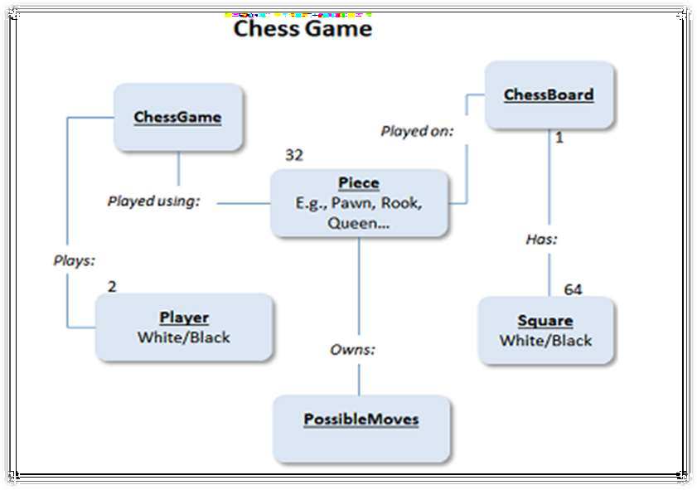
We'll be talking about a chess game and the various responsibilities and relationships between the objects and classes within the game.

Slide 10
CREATOR
Problem:
Assign responsibility for creating a new instance of some class?
Solution:
Determine which class should create instances of a class based on the relationship between potential creator classes and the class to be instantiated

Slide 11
CREATOR
The Creator defines WHO instantiates WHAT object. In object-oriented design speech, we need to ask the question of who creates an object A. The solution is that we give class B the role of instantiating (creating an instance of) a class A if:
B contains A
B uses most of A's features
B can initialize A
B aggregates A

Slide 12
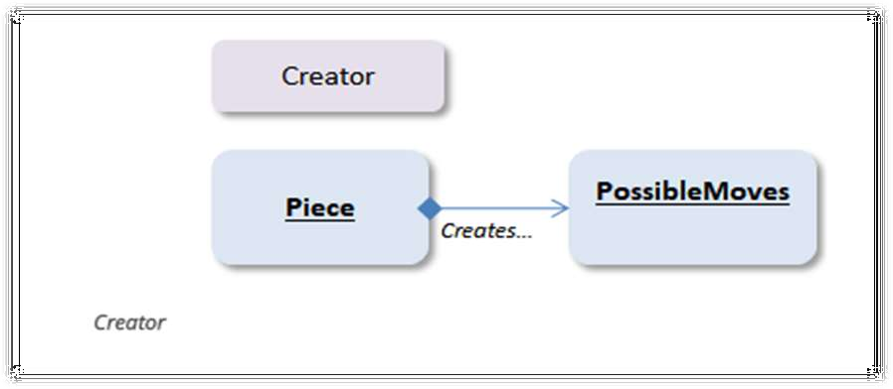
So far this doesn't really help us understand how this works. Let's use a real-world example of a chess game. A chess game includes 2 players, 32 pieces (16 per player) and a game board with 64 squares.

Slide 13
CONTROLLER
Problem:
To assign responsibility for handling a system event?
Solution:
If a program receive events from external sources other than its graphical interface, add an event class to decouple the event source(s) from the objects that actually handle the events.

Slide 14
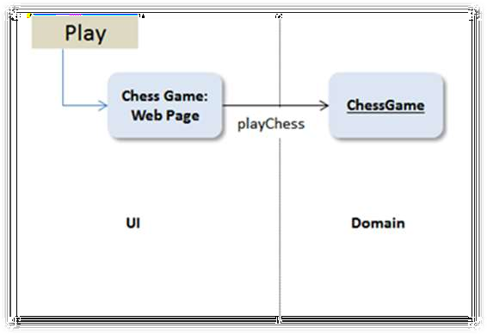
CONTROLLER
In our chess example, the end user is going to interact with our program through a user interface (UI). The Controller is the FIRST object to receive a command from the UI. In our case, when the user presses Play, the first object that should be triggered is the Chess Game.

Slide 15
INFORMATION EXPERT
Information Expert: Responsibility delegation principle/pattern
Problem: A system will have hundreds of classes. How do I begin to assign responsibilities to them?
Solution: Assign responsibility to the Information Expert – the class that has the information necessary to fulfill the responsibility.

Slide 16
INFORMATION EXPERT
Information expert is a principle used to determine where to delegate responsibilities. These responsibilities include methods, computed fields, and so on.
Using the principle of information expert, a general approach to assigning responsibilities is to look at a given responsibility, determine the information needed to fulfill it, and then determine where that information is stored.
Information expert will lead to placing the responsibility on the class with the most information required to fulfill it

Slide 17
INFORMATION EXPERT
The Information Expert pattern states that we need to assign responsibilities to the right expert. Is the game board itself the expert on how pieces can move or are the pieces themselves the experts at their moves? In the case of the chess board, the piece is the expert on the possible move options for that piece.

Slide 18
LOW COUPLING
Coupling is a measure of how strongly one element is connected to, has knowledge of, or relies on other elements. Low coupling is an evaluative pattern that dictates how to assign responsibilities to support
lower dependency between the classes,
change in one class having lower impact on other classes,
higher reuse potential.

Slide 19
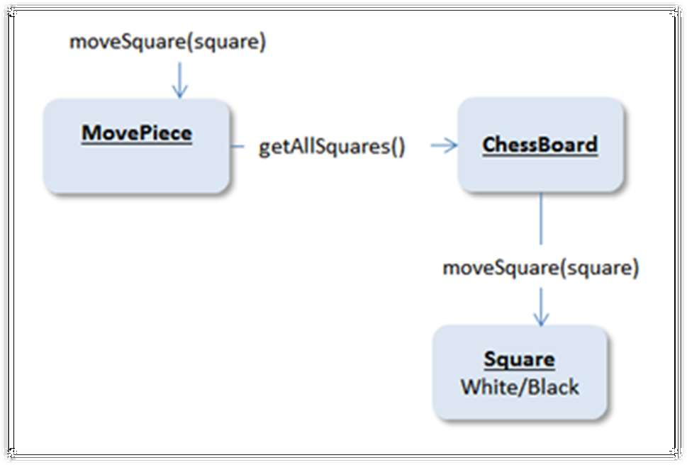

Slide 20
LOW COUPLING
Low Coupling can be described as following the path of least resistance.
Coupling is a measure of how much objects are tied to one another. We can follow the information expert for the lowest level of coupling. So, to get the moves available to a piece, we start with the information expert, and not some other class.
In the chess game, the MovePiece class needs to get information from the board and the place it intends to move to. We can couple all of this together in one flow:

Slide 21
COUPLING
Inheritance is a strong form of coupling. Any decision to create an inheritance relationship between two classes should be considered carefully.
Is no coupling between classes a good thing?
An object-oriented system is a system of collaborating objects. Some moderate degree of coupling between classes is normal and necessary .

Slide 22
HIGH COHESION
It is important to have code that is clean.
Objects need to be manageable, easy to maintain and have clearly-stated properties and objectives.
This is High Cohesion which includes defined purposes of classes, ability to reuse code, and keeping responsibility to one unit.
High Cohesion, Low Coupling, and clearly defined responsibilities go together.
To achieve High Cohesion, a class should have ONE job.
A game piece should move across the board. It should not need to setup the board or define moves for other players.

Slide 23
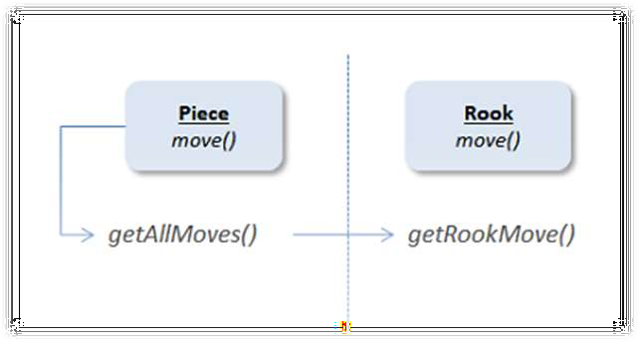
INDIRECTION
In order to support lower coupling between objects, we look for Indirection, that is creating an intersection object between two or more objects so they aren't connected to each other.
Indirection and Polymorphism go hand in hand.

Slide 24
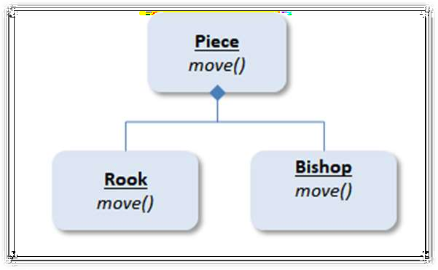
POLYMORPHISM
This sounds like a science fiction term, but polymorphism really means that one thing can be performed in different ways. All chess pieces can move, but each has a special way of moving.

Slide 25
PROTECTED VARIATION
The protected variations pattern protects elements from the variations on other elements (objects, systems, subsystems) by wrapping the focus of instability with an interface and using polymorphism to create various implementations of this interface.

Slide 26
PURE FABRICATION
A pure fabrication is a class that does not represent a concept in the problem domain, specially made up to achieve low coupling, high cohesion, and the reuse potential thereof derived (when a solution presented by the information expert pattern does not).
This kind of class is called a "service" in domain-driven design.

Slide 27
OVERVIEW
Informational Expert | Assign a responsibility to the class that has the information needed to fulfill it..
Creator | Assign class B the responsibility to create an instance class A if one of these is true (the more the better): B ”contains” or compositely aggregates A. B records A. B closely uses A. B has the initializing data for A that will be passed A when it is created. Thus B is an Expert with to creating A.
Controller | Assign the responsibility to a class representing one of the following choices: Major subsystem classes A use case scenario classes within which the system event occurs.
Low Coupling | Assign a responsibility so that coupling remains low.
High Cohesion | Assign a responsibility so that cohesion remains high.

Slide 28
OVERVIEW
Polymorphism | The same name operations (methods) in the difference classes is defined. And assign a responsibility to the class the class that the behavior is changed.
Pure fabrication | Define a class for convenience sake that doesn’t express the concept of the problem area at all.
indirection | Assign the responsibility to an intermediate object to mediate between other components or services, so that they are not directly coupled.
Protected variation | Assign responsibility to create a stable interface around unstable or predictably variable subsystem

Slide 29
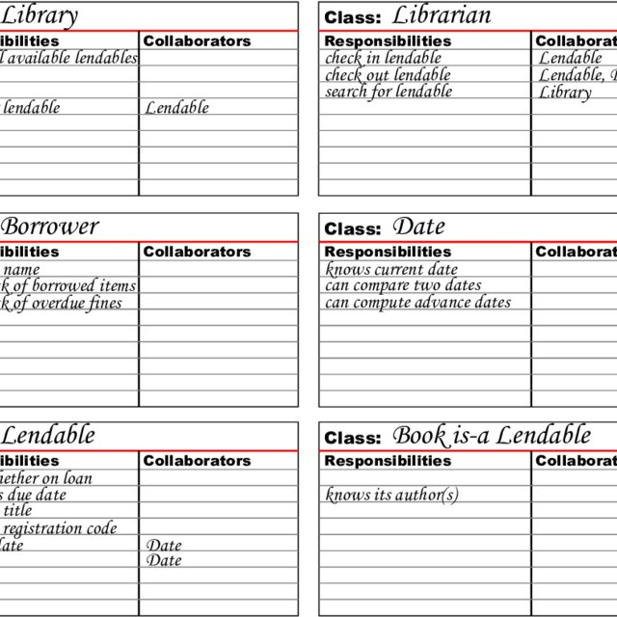
Assigning Responsibilities –Other Sources
CRC Cards:
Another popular technique to assigning responsibilities to classes is to use CRC cards CRC = Class: Responsibility: Collaboration
Introduced by Kent Beck and Ward Cunnigham

